Slide 1
How to nominate
www.wanmea.com.au

Slide 2
Be part of something special
www.wanmea.com.au

Slide 3
About the awards
Established in 2003 by the Nursing and Midwifery Board of Western Australia
With the move to national registration the WA Minister for Health delegated coordination of the awards to the Nursing and Midwifery Office
All Western Australian nurses and midwives currently registered and working in a public or private WA healthcare setting are eligible for nomination
www.wanmea.com.au

Slide 4
Why nominate?
To publicly recognise:
Excellence in the nursing and midwifery professions
The valuable work of our nurses and midwives
Role models and their impact on current and future nurses and midwives
To shed light on:
Individuals who excel and do amazing things
The professions – raising awareness in the community gaining positive exposure
www.wanmea.com.au

Slide 5
Recognition
Finalists will be invited to attend the WA Nursing and Midwifery Excellence Awards Gala Dinner
Finalists will be listed in a media statement and may be contacted for a media interview
All finalists will have their profile and picture printed in the Awards Program and will be recognised on the night
Winners will be announced in a media statement following the Gala Dinner and may be contacted by media for interview
www.wanmea.com.au

Slide 6
What are the categories?
Consumer Appreciation – for patients, consumers and significant others to nominate a nurse and/or midwife
12 General Categories – for health care colleagues to nominate their peers in various nursing and midwifery streams or practice environments
Lifetime Achievement Honour – nominate a nurse or midwife who has had a highly impactful career to be inducted to the Lifetime Achievement Honour Roll
www.wanmea.com.au

Slide 7
Consumer Appreciation
In 500 words or less describe
how the nurse or midwife you are nominating promotes health, safety and well-being within the community
the circumstances that led you to nominate this nurse or midwife and the attributes/actions you observed of the nurse or midwife that prompted the nomination
www.wanmea.com.au

Slide 8
General Categories
Excellence in Aboriginal Health
Excellence in Education
Excellence in Enrolled Nursing
Excellence in Leadership – Emerging
Excellence in Leadership - Established
Excellence in Midwifery
Excellence in Primary, Public and Community Care
Excellence in Registered Nursing
Excellence in Research
Excellence in Rural and Remote Health
Excellence in Residential Care
Graduate of the Year
Check the Nominations Explained section on our website for more information
www.wanmea.com.au

Slide 9
General Categories cont…
Briefly describe the nurse or midwife’s role and associated responsibilities
Explain how the nurse or midwife displays excellence and stands out by using the following headings (each worth 25% weighting and 250-word limit)
Advancing the professions
Innovative practice, ideas or ways of working
Partnerships
Making a difference
www.wanmea.com.au

Slide 10
Lifetime Achievement Honour
The Lifetime Achievement Honour is not a category of the awards
The Lifetime Achievement Honour is an induction onto an honour roll at the annual WA Nursing and Midwifery Excellence Awards Gala Dinner
Nominate a nurse or midwife who has had a highly impactful career and has changed the profession’s landscape in Western Australia, nationally and/or internationally
www.wanmea.com.au

Slide 11
Nominate a Lifetime Achievement Honour
This is a confidential nomination
You will need to provide up to 4 referees for the investigating panel to contact to undertake research
You will need to provide a statement about why you believe your nominee is worthy of this honour
As a guide, consider the following questions:
In what role(s) or area(s) has the nominee excelled?
How has the nominee demonstrated service worthy of recognition?
How has the nominee’s contribution impacted on the nursing and/or midwifery professions or community in WA, nationally and/or internationally?
Explain the broad nature of the person’s influence and associated impact on their profession.
Over what period of time has the nominee made a major commitment?
Has the nominee’s contribution been recognised elsewhere?
What makes this person stand out from others?
How does this person inspire you?
www.wanmea.com.au

Slide 12
Assessment Process for Consumer Appreciation and General Categories
Short-listing
All nominations are placed into the individual categories and assessed by 3 panel delegates
The panel discuss and agree on scores and rankings to ascertain finalists using nominator, nominee and referee statements
Judging
The judging panel discuss and rank the finalists using nominator, nominee and referee statements
The judging panel agree on a winner of each category
Each category winner is then considered by the judging panel to determine who will be named overall WA Nurse/Midwife of the Year
www.wanmea.com.au

Slide 13
Assessment Process for Lifetime Achievement Honour
Nominees remain anonymous
Unsuccessful nominees are not announced and should never know they were nominated
An independent research officer investigates and collects evidence from the nominator and referees provided in the nomination for an independent advisory body to assess
The WA Nursing and Midwifery Lifetime Achievement Council (the Council) meets to consider all nominations and make recommendations to the WA Minister for Health
www.wanmea.com.au

Slide 14
Assessment Process for Lifetime Achievement Honour
The Council consists of members from across Australia and includes senior nurses and midwives, respected business leaders and members of the community
The degree and value of the contribution of service, rather than length of service, is the primary focus of consideration
After assessing the nominations the Council recommends a list of recipients to the WA Minister for Health for approval
Successful recipients to the Lifetime Achievement Honour Roll are advised of their nomination
www.wanmea.com.au

Slide 15
Tips from the Short-listing Panel
Make sure your nomination addresses ALL the questions and selection criteria
Provide examples of how your nominee stands out from other nurses and midwives when addressing the criteria
Proof read your nomination before submitting
www.wanmea.com.au

Slide 16
How to nominate
You can nominate at www.wanmea.com.au
Click on ‘Nominate Now’
www.wanmea.com.au

Slide 17
You will see
www.wanmea.com.au

Slide 18
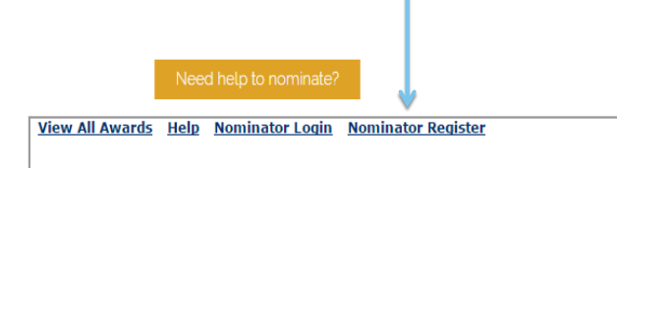
If you have not registered before
Click Nominator Register
www.wanmea.com.au

Slide 19
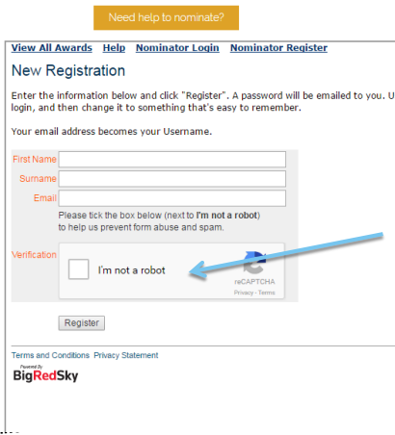
New registration
Fill out your details and click the I’m not a robot box
Click ‘Register’
A password will be emailed to you.
Login using this password and follow instruction to change this to something you will remember
www.wanmea.com.au

Slide 20
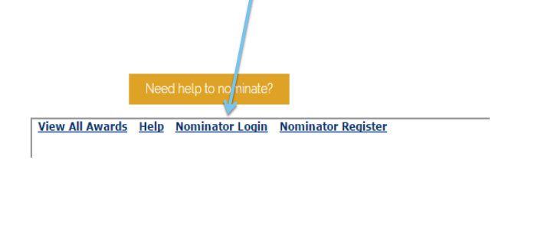
If you have registered before
Click Nominator Login
www.wanmea.com.au

Slide 21
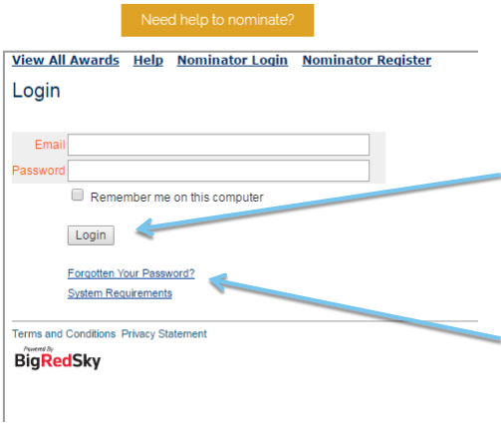
Nominator login
Enter your email and password (case sensitive)
Click Login
If you can’t remember your password, click ‘Forgotten Your Password?’ and the system will send you a new one
www.wanmea.com.au

Slide 22
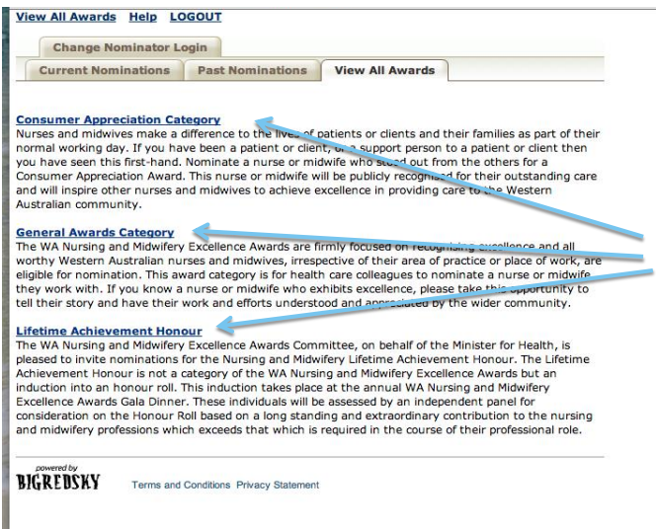
Nominating
Once you are logged in you will see this screen
Select the category you wish to nominate your chosen nurse or midwife in
You will be taken to an ‘advert’
www.wanmea.com.au

Slide 23
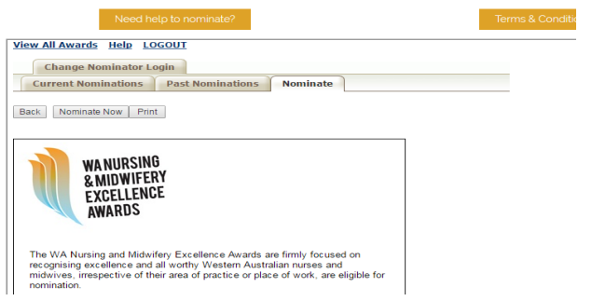
The Advert
Please read through the advert. This provides information about what is required within the nomination including the selection criteria to address
You have the option to ‘nominate now’ or ‘print’ the advert
Choose ‘nominate now’ and complete all fields within the nomination
www.wanmea.com.au

Slide 24
Edit and Save
If you wish to exit your nomination at any stage ‘save’ and ‘logout’. All information to this point will be saved
‘Save’ your work frequently
The system may time-out without warning if you have been logged in longer than an hour
Edit, update or withdraw nominations by selecting the appropriate tab
www.wanmea.com.au

Slide 25
Some Tips
Do not leave nominating until the last day
Late submissions CAN NOT and WILL NOT be considered
You will receive an email to confirm the receipt of your nomination. If you do not receive this, your nomination has not been received
To submit another nomination – click ‘view all awards’ to return to the menu
www.wanmea.com.au

Slide 26
Some More Tips
All questions are mandatory fields
If a field is unknown please type ‘unknown’
Once the first page is complete you can ‘save’ your nomination and return later to complete the rest of the nomination
Click ‘next’ to continue through the nomination
On the final page ‘tick’ the box to accept you have read and understood the terms and conditions
Click ‘submit nomination’
www.wanmea.com.au

Slide 27
Contact details
www.wanmea.com.au
WANMEA@health.wa.gov.au
Tel: 0448 725 776
www.wanmea.com.au

